Slide 1
Week 5: Definition, paraphrasing and summarizing
Dr. Liu Lisha

Slide 2
Outline
Definition
Paraphrasing(Quoting)
Summarizing

Slide 3
Academic writing
Academic writing
Writing skill
Writing definitions
Getting the skill
A definition is a statement that explains the meaning of a term (a word or a phrase). The primary reason to include definitions in your writing is to provide clarity and avoid misunderstanding. A formal definition generally consists of three parts:
the term to be defined
the category to which the term belongs
the characteristics that distinguish it from other members of its category
In the student model essay, the writer defines the term “polio” as follows:
Polio [word being defined] is an infectious disease [category] that destroys muscles [characteristics].

Slide 4
Academic writing
Academic writing
Writing skill
Task 1
Getting the skill
Read the sentences and identify the word being defined, the category and the characteristics.
[word being defined]
[category]
[characteristics]
Flu is a contagious illness transmitted between individuals.
Quarantine is a period of time when a person or animal is kept apart from others in case they are carrying a disease.
A campaign is a series of organized events for raising awareness of and protesting against an issue.

Slide 5
How do we improve our referencing skills?
Claim
(your ideas)
Evidence
(sources)
A clear topic sentence
Quoting
Paraphrasing
Summarizing
Do you agree or disagree that being a fan of a showbiz celebrity is going to curb a teenager's development. Please use reasons to support your argument.

Slide 6

(1) Quoting
Not so academic:
Someone says, “…”.

Slide 7
(1) Quoting continued
Here is a second example to quote direct sources:
According to APA Publication Manual, “Reproduce word for word material directly quoted from another author’s work …, material replicated from a test item, and verbatim instructions to participants” (2010, p.170) .

Slide 8
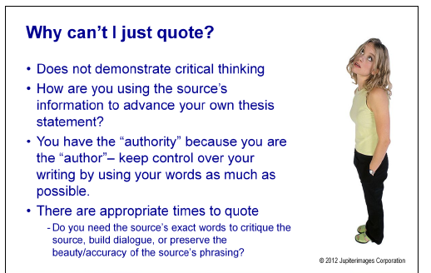

Slide 9
(2) Paraphrasing
Definition:
“Rewrite information from an outside source in your own words without changing the meaning” (Oshima & Hogue, 2000, p. 127)
Two essential characteristics:
In your OWN words
maintain the ORIGINAL meaning

Slide 10
(2) Paraphrasing
Paraphrasing as a basic technique in academic writing
It is important because…
It helps to support your thesis statement
It helps to avoid plaigiarism
It helps to demonstrate your English writing abilities (as opposed to unnecesary direct quotations)

Slide 11
Paraphrasing skill
The exact meaning of the source remains but the way this is expressed is changed.
An effective paraphrase:
Has a different structure to the original
Has different vocabulary
Keeps the original meaning
Is referenced

Slide 12
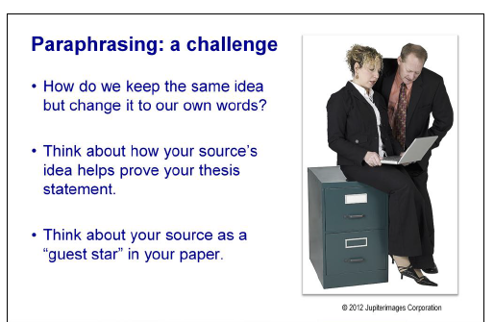

Slide 13
How to paraphrase?
Step 1: read and understand
Step 2: take notes of a few words and/or the outline
Step 3: think about the synonyms of the key words
Step 4: Write your paragraphse from your notes
Step 5: check your paraphrase against the original
Step 6: add an in-text citation at the end

Slide 14
Examples of Paraphrase
Original:
Thailand’s economy remains sound. GNP growth nearly reached 10% last year and should continue to be strong because of the many major projects in the pipeline. Although the balance-of-payment outlook for the next few years is clouded, the development of natural gas should begin to diminish Thailand’s dependence on imported energy by 2001.
Paraphrase:
According to van Agmael (1996), the future of Thailand’s economy seems healthy. If the GNP continues to grow at about 10% per year, many important projects already planned can be implemented. In addition, Thailand’s natural gas development will reduce her need to depende on foreign energy.
Remember to cite the source !

Slide 15
Steps toward good paraphrasing:
Read the original message carefully.
Make sure you understand.
Rewrite in your own words without copying, change the vocabulary and grammar, yet do not change the original meaning. (Synonyms)
Keep similar length.
Cite the paraphrased text.

Slide 16

Good or bad paraphrasing?
Living aboard a space station in orbit around Earth for months at a time poses problems for astronauts’ bodies as well as for their minds.
Source: Clinton, P. (2003). Manned Mars flight: impossible dream? Space Science, pp.16.
Living aboard a space station in orbit around Earth for months at a time poses issues for astronauts’ bodies as well as for their minds (Clinton, 2003).

Slide 17
Good or bad paraphrasing?
“Living aboard a space station in orbit around Earth for months at a time poses problems for astronauts’ bodies as well as for their minds.”
Source: Clinton, P. (2003). Manned Mars flight: impossible dream? Space Science, pp.16.
An article in Space Science reports that astronauts will become physically sick and have mental problems if they visit a space station (Clinton, 2003).

Slide 18

Good or bad paraphrasing?
“Living aboard a space station in orbit around Earth for months at a time poses problems for astronauts’ bodies as well as for their minds.”
Source: Clinton, P. (2003). Manned Mars flight: impossible dream? Space Science, pp.16.
An article in Space Science magazine reports that lengthy space station duty may lead to physical and mental problems for astronauts (Clinton, 2003).

Slide 19
Common pitfalls
Paraphrase one sentence after another
Replace words with synonyms without changing the sentence structure
Omitting essential information
Misrepresent the original meaning

Slide 20
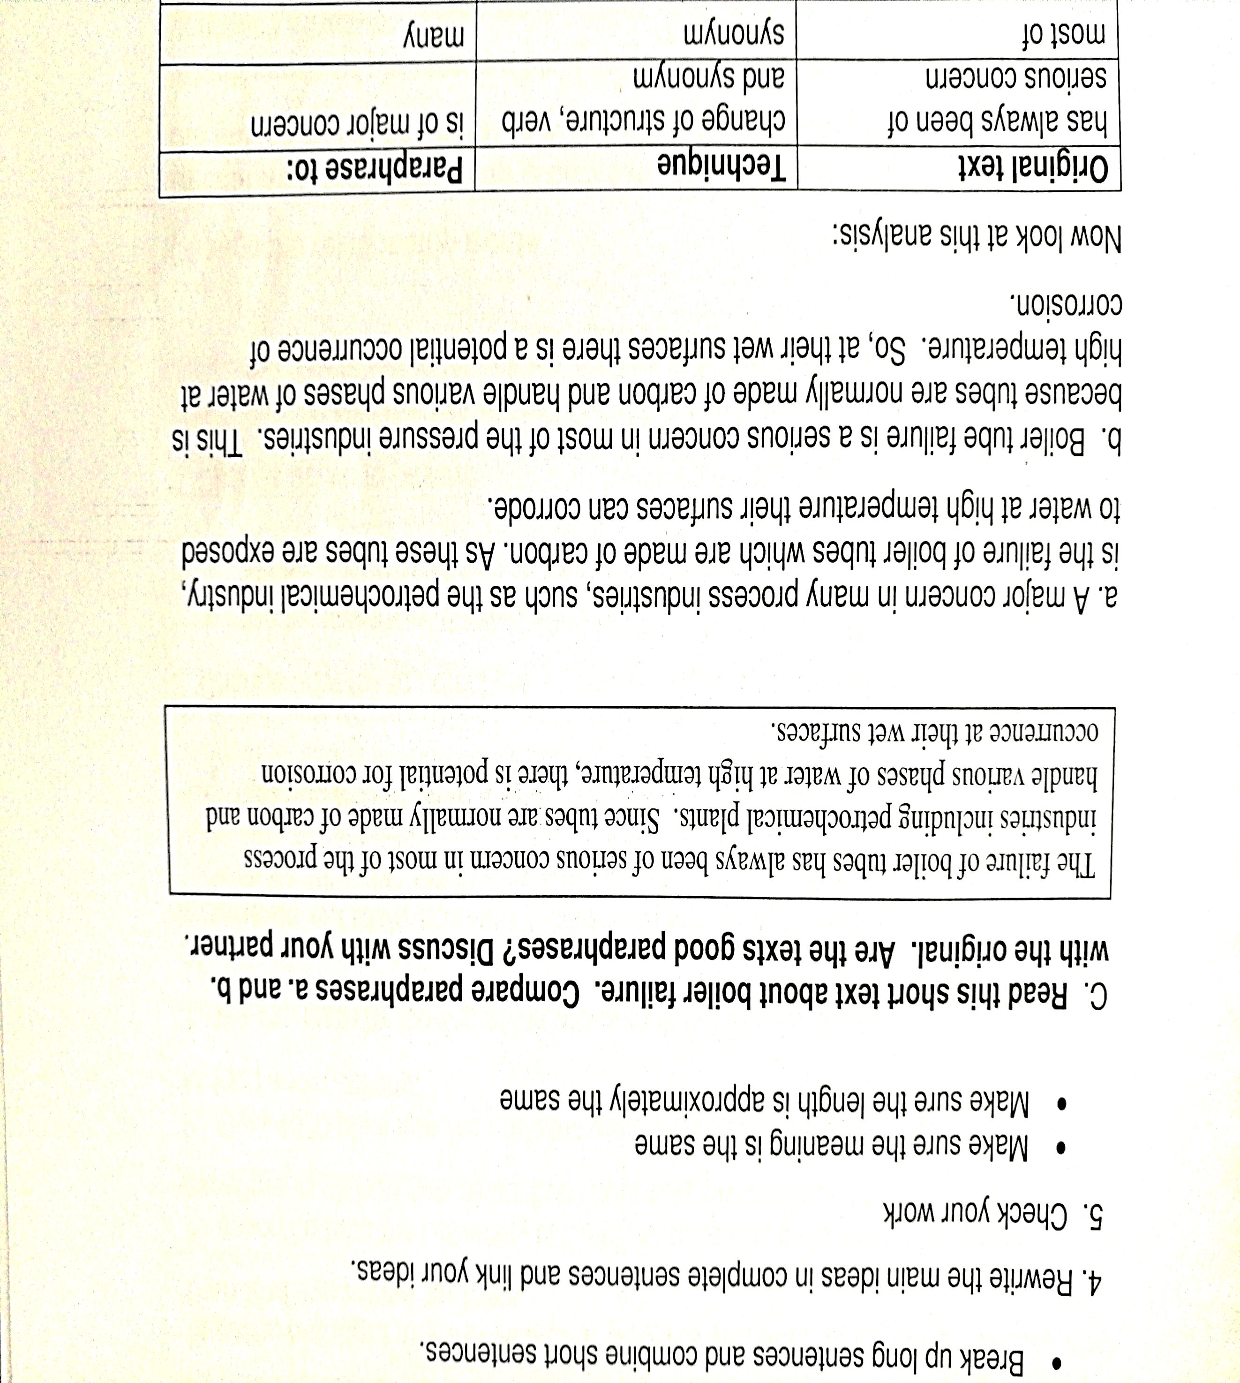
Exercise

Slide 21
Please paraphrase this text
Over-population, pollution, climate change, poor sanitation, and rising sea levels are contributing to a scarcity of fresh water. Over the long term, this scarcity could become a crisis for the world, causing wars as billions of people will compete over access to vital fresh water supplies in the future.
A shortage of fresh water to supply the billions in the world is apparently serious enough that it could eventually lead to wars. Among the factors contributing to the drop in fresh watersupplies are issues related to the increasing population,sanitation, and environment.

Slide 22
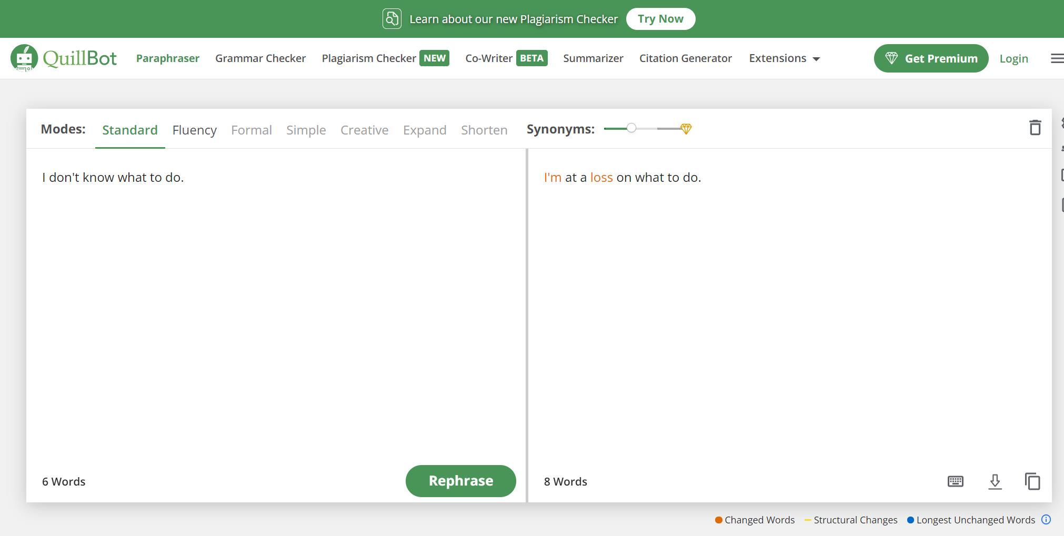
Paraphrasing tools
AI paraphrasing tool: https://quillbot.com/ (150 words, 10 times)

Slide 23
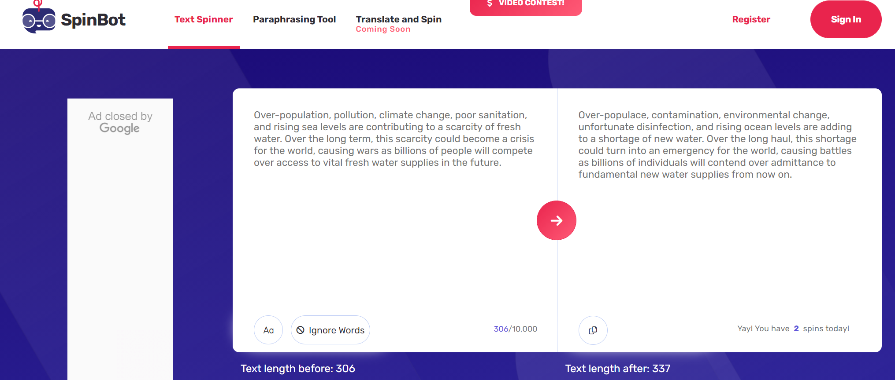
Paraphrasing tools
AI paraphrasing tool: https://spinbot.com/ (1000 words)

Slide 24
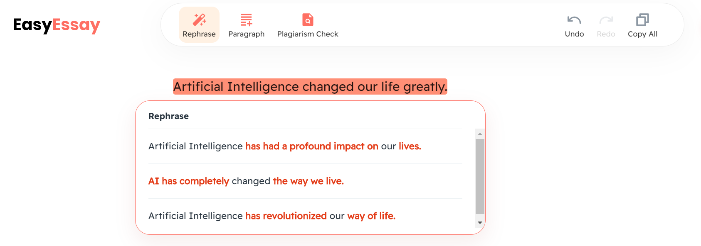
Paraphrasing tools
AI paraphrasing tool: https://www.easyessay.ai/writing

Slide 25
Outline
Definition
Paraphrasing(Quoting)
Summarizing

Slide 26
Definition of a summary
A summary is a shortened version of the original.
★highlight the major points
★get the gist(main points) in a short period of time.
★be written in your own words

Slide 27
Characteristics of a good summary
a summary must be comprehensive
a summary must be concise
a summary must be coherent
a summary must be independent

Slide 28
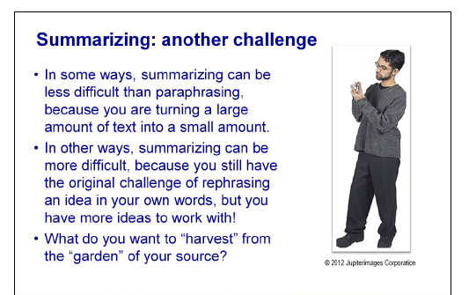

Slide 29
Summarizing tips
Do:
1. use your own words.
2. only note the most important points, using key words and phrases.
3. read the original text, ensuring you don't miss any critical points.
4. ensure a summary is much shorter than the original source.
5. include the original source in the references for a written document.
Don't:
1. include unnecessary details, examples or supporting information.
2. include your own opinions or thoughts.
3. repeat phrases word for word - this is plagiarism.

Slide 30

Steps of summary writing
reading
writing
modifying

Slide 31
First: reading
1. Skim and scan the text to identify the topic and to understand how the information has been organized.
2. Reading carefully. Make a note of the writer's main points in your own words.

Slide 32
Second: writing
1. use your own words
2.write in the third person -- the passive voice

Slide 33
Third: modifying
1. omit repetition and details
2. revise the writing until you are sure that you have an accurate summary which flows logically.

Slide 34
Some skills of writing a summary
Skill 1 : Omit the details
Skill 2 : Omit the repetitions
Skill 3 : Omit the examples
Skill 4 : Use general words instead of specific words
Skill 5 : Put the main points of a dialogue in the passive voice
Skill 6 : Find out the topic sentence or the key words

Slide 35
Some examples
1. You can think of a way to manage your temper. Here are some tips:
1) We should try to calm down and figure out what we are really upset about.
2) Keep a diary. It can help you understand more about yourself and your feelings.
3) We can try to talk with our best friends to release stressful emotions.
Summary:
Skill ___________________
There are many tips for you to manage your temper.
3: Omit the examples

Slide 36
2. Nowadays more and more teenagers try to be more independent from their parents and sometimes become very rebellious. They always want to wear long and strange hair style, which their parents complain about a lot. They also spend too much time on the Internet and playing computer games.
Summary:
Skill ____________________
Nowadays, there is an increasing tendency that more and more teenagers try to behave independently and differently.
1: Omit the details

Slide 37
Academic examples of summary
The original passage:
Students frequently overuse direct quotation in taking notes, and as a result they overuse quotations in the final [research] paper. Probably only about 10% of your final manuscript should appear as directly quoted matter. Therefore, you should strive to limit the amount of exact transcribing of source materials while taking notes. (Lester, James D. Writing Research Papers. 2nd ed. (1976): 46-47.)
An acceptable summary:
Students should take just a few notes in direct quotation from sources to help minimize the amount of quoted material in a research paper (Lester 46-47).

Slide 38

AI tool: Paper Digest
https://www.paperdigest.org/

Slide 39
Paraphrasing vs. Summary
A paraphrased text
About the similar length of the original text
(Usually) do not stand alone
Summary:
Much shorter
Can refer to a genre of academic writing (e.g., a summary of a journal article, a summary of a book, a summary of a book chapter, etc.)

Slide 40
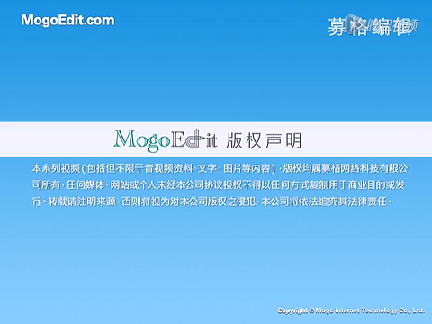
Review
What is “plagiarism”?
Why do we need to know?
How do we improve our referencing skills?
Notes:
1st 45-min session

Slide 41
Thank You !

